Slide 1
Methodology for Scientific Discoveries in Mental Health
Zhiling Zhang
2022.6.1

Slide 2
Contents
Motivation
Methodology
Association
Causality
Applications in mental health research
Conclusion

Slide 3
Our current research focus
Machine learning algorithms
Model structure, optimizer, data processing, …
Goal: optimize the algorithm performance
Purpose: automatic decisions by machine
Example: Mental Disease Detection, Symptom Identification, …
Notes:
The current research focus for most of us should be machine learning algorithms.
We modify xxx to optimize the algorithm performance, so that we can use machine to make better automatic decisions in many applications
For example, my recent papers are about mental disease detection and symptom identification

Slide 4
Scientific Discovery for human action
Now that we can detect diseases like Depression
But how can we treat them?
Researches show that exercising can improve mood
Do more exercise
Psychological Counselling has been proved effective for depression
Visit a psychological counselor
Notes:
xxx. We may know some researches show that xxx (1,2,3,4)
We can see that it’s our action, instead of ML, that can help us truly handle these problems. And scientific discoveries can let us know what is the right thing to do (5)
Therefore, today’s topic will focus on Scientific Discovery for human action.

Slide 5
Data Science
Goal: Explainable relations between variables
Associations & Causality
Purpose:
Discover rules and knowledge about the world
Assist human action
Methods
Data Analysis, Data Mining
Statistics & Machine Learning
Notes:
We would use techniques from Data Science for scientific discoveries. Here is my understanding of Data Science.
A major goal of DS is to find xxx, which typically has two forms: Associations & Causality. (1)
With DS, we can xxx (2)
To achieve these, we will use data analysis & data mining techniques, which involves statistics and ML.

Slide 6
Focus of Data Science
Reliability / Validity of the conclusion
Hypothesis: Smoking is good for health
Support: “My 90-year-old grandpa smokes every day”
Against: Large-scale study showing that smokers lives shorter
Strength of the relation
Example: Choosing between two valid therapies
Effective Rate of Therapy A: 80% VS Therapy B: 90%
(Unreliable)
(More reliable)
Notes:
There are 2 main focus of DS
The first is xxx(1). Given a hypothesis, we can have evidence on both sides. (2) The supporting one says xxx, and the evidence against this is a xxx
It is clear that (3) the supporting one is unreliable as it is a single case, and the against is more reliable as it is proved in larger scale.
Therefore, we know that the hypothesis is not reliable, and we should trust it.
Another focus is Strength of relation. (4)
For example, we want to choose from two therapies that have both been proven to be valid (5)
But given the effective rate, it is clear we will prefer therapy B (6) as it is stronger, if it doesn’t have other disadvantages

Slide 7
Contents
Motivation
Methodology
Association
Causality
Applications in mental health research
Conclusion
Notes:
Now let’s discuss how to make scientific discoveries with DS, on the level of Association or Causality

Slide 8
Association between Categorical Variables
Hypothesis: Radiation may affect people’s health
Contingency Table/Crosstab
Exposure to radiation can increase disease rate by 4%
 | Diseased | Healthy | Disease Rate
Exposed | 20 | 380 | 5%
Not Exposed | 6 | 594 | 1%
Notes:
First, I will show you an example about the association between categorical variables.
We will usually make a hypothesis about the relation between two variables.
For example, we want to know if radiation will affect people’s health.
Then we will collect data about the two variables.
For categorical variables, we can gather the co-occurrence frequency and put them into a cross table or called contingency table.
From the table we can easily calculate the disease rate (1) of each exposure group.
Then comparing them (2), we know that xxx, so there might be association between the 2 variables.

Slide 9
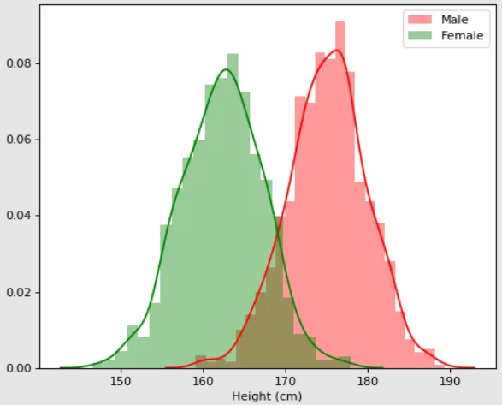
More kinds of Associations
Categorical VS Numerical
E.g. Gender and Height
Numerical VS Numerical
E.g. Education year VS Wage

Slide 10


Reliability of Associations
Hypothesis test and Confidence Interval (CI)
Null Hypothesis: $H_{0}:μ_{male}=μ_{female}$
Given significant level $α=0.05$, $μ_{male}$ is out of 95% CI of female distribution
Reject $H_{0}$, and we can confidently say men are generally higher than women
$$μ_{male}$$
Notes:
Now we have found associations, but have can we characterize the reliability of the association?
We will use hypotheses test, which can closely related to confidence interval (CI).
Since you should have learnt this from the textbook, I will not go to the mathematical details, but just have a recap of the basic procedure.
Suppose we want to show that men are generally higher than women. We should make a null hypothesis that the mean height of male and female are equal. However, given xxx.
So we can reject H0 and say that

Slide 11
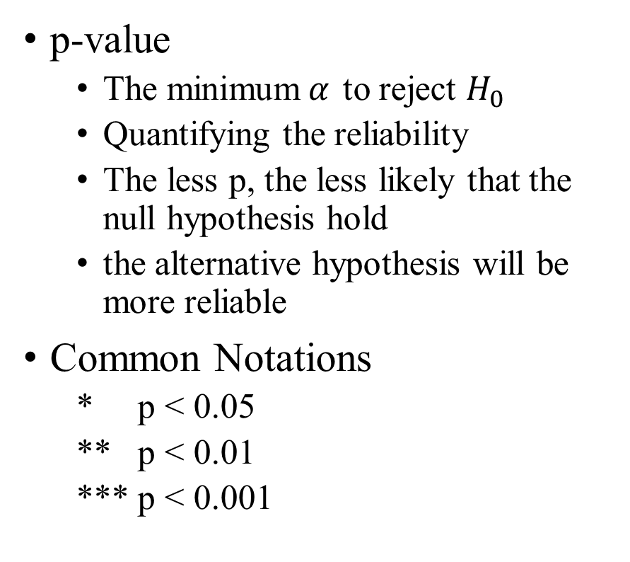
Reliability of Associations
p-value
The minimum$α$ to reject $H_{0}$
Quantifying the reliability
The less p, the less likely that the null hypothesis hold
the alternative hypothesis will be more reliable
Common Notations
* p < 0.05
** p < 0.01
*** p < 0.001
Notes:
Another important part of hypothesis test is p-value. I remember that this is not included in SJTU’s undergraduate course, so I will give a brief introduction.
P-value is defined as xxx, and as the figure shows it is also the probability of xxx, which is the green area.
It can be used to quantify the reliability, as the less p, the less likely that the null hypothesis hold, and the alternative hypothesis will be more reliable
You may have seen these stars on many research papers, now we know that the more stars, the lower p, the more reliable is the conclusion.
(The example is one-sided hypothesis test)

Slide 12
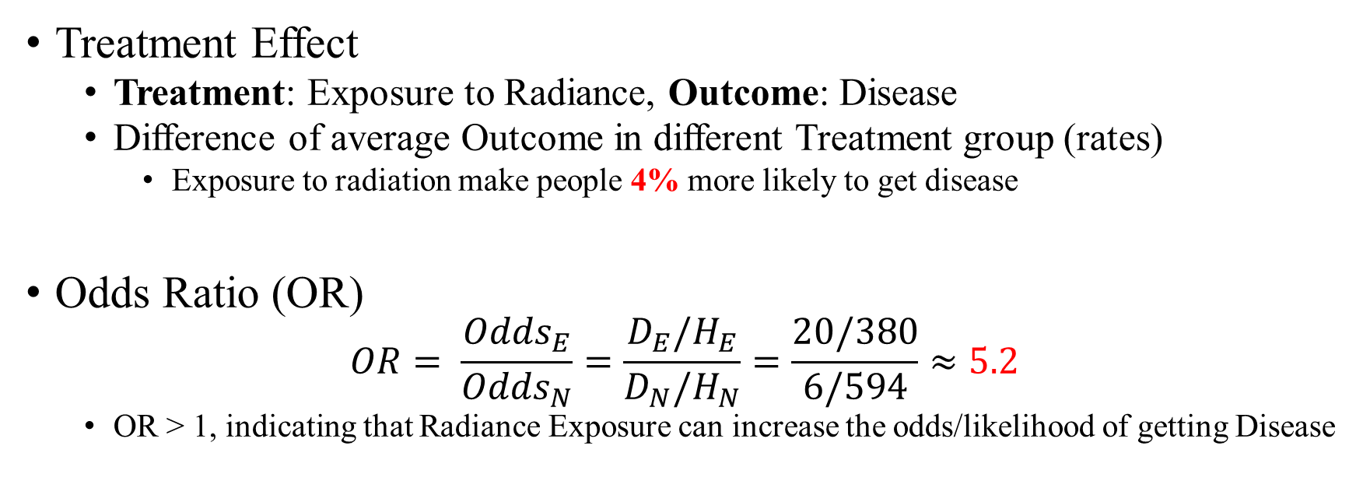
Strength of Association (Effect Size)
 | Diseased (1) | Healthy (0) | Disease Rate
Exposed | 20 | 380 | 5%
Not Exposed | 6 | 594 | 1%
Treatment Effect
Treatment: Exposure to Radiance, Outcome: Disease
Difference of average Outcome in different Treatment group (rates)
Exposure to radiation make people 4% more likely to get disease
Odds Ratio (OR)
$$OR= \frac{{Odds}_{E}}{{Odds}_{N}}=\frac{D_{E}/H_{E}}{D_{N}/H_{N}}=\frac{20/380}{6/594}≈5.2$$
OR > 1, indicating that Radiance Exposure can increase the odds/likelihood of getting Disease
Notes:
Now we focus on another focus, the strength of association, which is also called Effect Size 效应量 in many literatures.
First, we can measure the effect size with treatment effect. We first define treatment and outcome variable. They are like cause and effect, and we want to see the effect on disease rate by changing the exposure to radiance. And the effect can be simply measured by the Difference of average Outcome in different Treatment group. We can consider disease as a binary variable with diseased as 1, then the average outcome is the rate. Then we know xxx
(2) Another measurement is called Odds Ratio (OR). OR can be calculated like this.
You don’t need to remember the equation, but I just want to give you an intuition that OR > 1, indicating that Radiance Exposure can increase the odds/likelihood of getting Disease

Slide 13
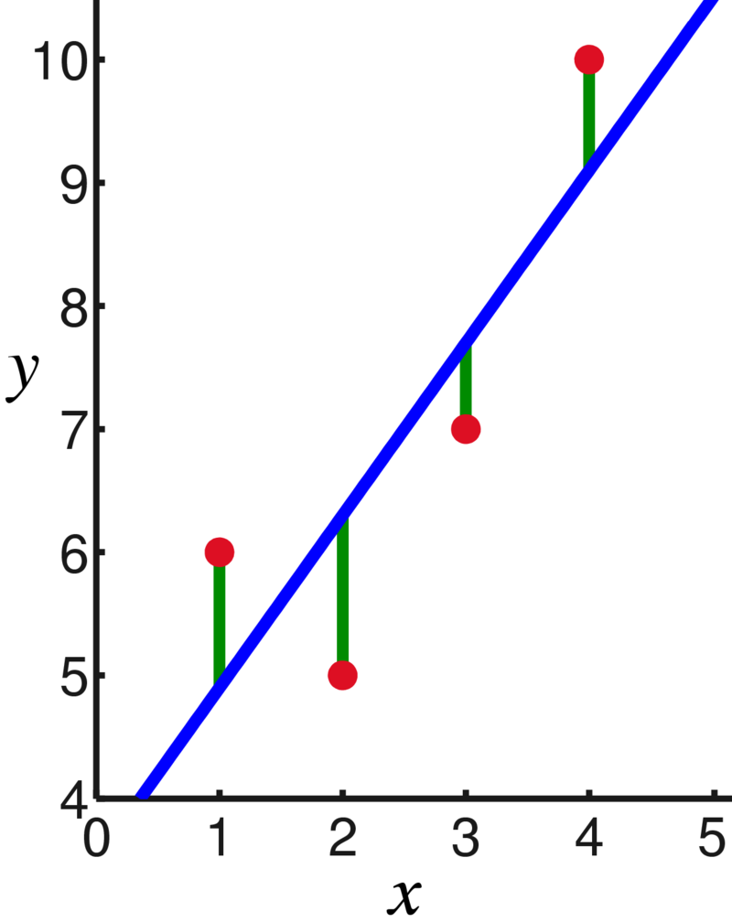
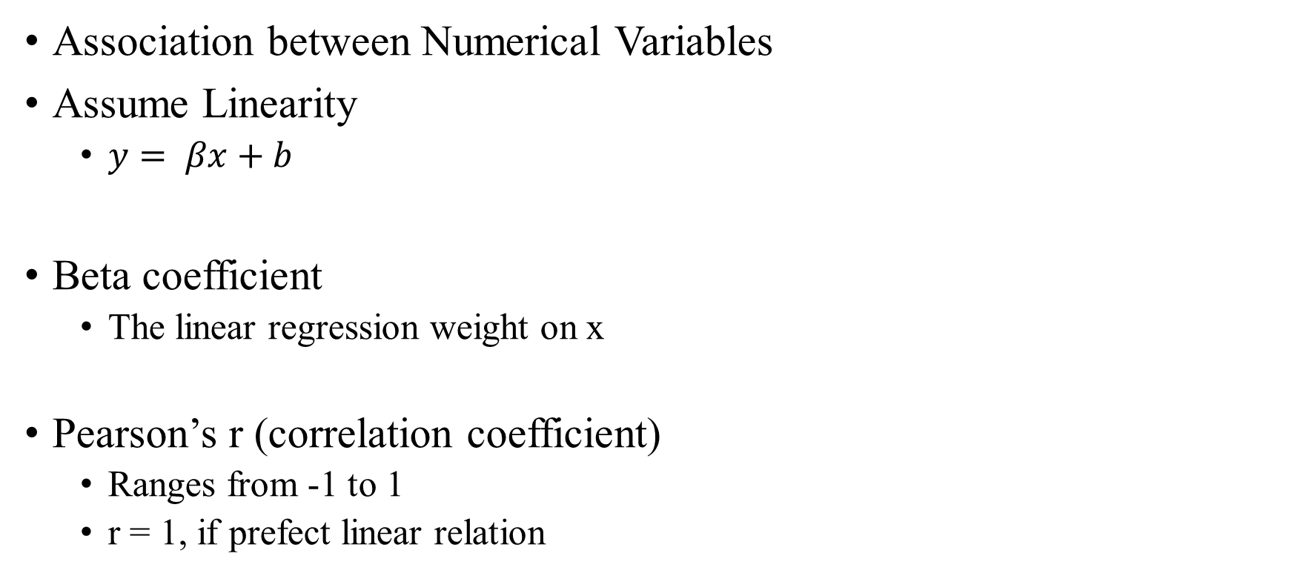
Strength of Association (Effect Size)
Association between Numerical Variables
Assume Linearity
$y= βx+b$
Beta coefficient
The linear regression weight on x
Pearson’s r (correlation coefficient)
Ranges from -1 to 1
r = 1, if prefect linear relation

Slide 14
Quiz: Recap of Concepts
We want to study the relation between Phone use time and Happiness Level, which one can we use to characterize relation strength?
A. Odds Ratio (OR) B. Beta coefficient
We want to know if achieving SOTA can raise the chance of paper acceptance, which one can we use to characterize relation strength?
A. Treatment Effect B. Pearson’s r
We’ve made a hypothesis test, which p-value indicates a more reliable conclusion?
A. 3e-4 B. 0.123
Notes:
Do you have any questions?

Slide 15
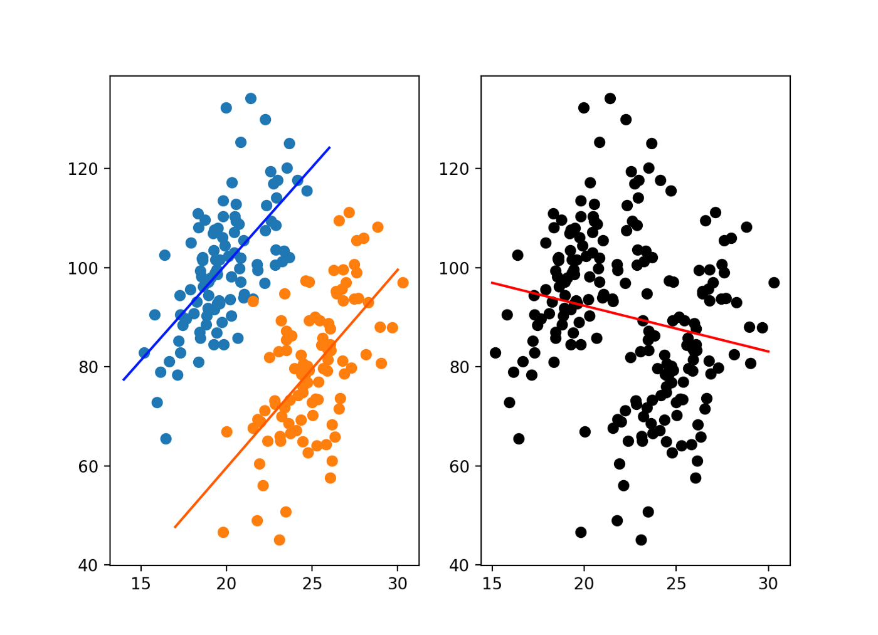
Simpson’s Paradox
Experiment on the effect of a drug
X: Drug dosage
Y: Health indicator (higher is better)
Linear Regression
Negative beta, larger dosage has worsen the case
Regression by group (initial severity)
The correlation reversed!
Association is not Causality
Control Confounder(干扰因子) to reduce bias
Mild
Severe
Notes:
Now we want to study the effect of a drug, the treatment X is xx and the Outcome Y is xxx.
We used a linear regression and found that the beta is negative, indicating that larger dosage has worsen the case. This is unbelievable!
Then we can introduce a third variable, the initial severity(1). And we separately perform regression on each group. (2) We can find that the correlation is reversed!
One possible explanation is that Patient with severe symptoms already have poorer health at the beginning, and we tend to use higher dosage for them.
So after all the drug is still effective.
(3) This is an example of the famous Simpson’s paradox. (4) An important lesson is that Association is not Causality.
(5) To capture the true causality, we need to Control Confounder(干扰因子) to reduce bias
What is Simpson’s Paradox?. And what does it have to do with the… | by Tim Copeland | Towards Data Science

Slide 16
Graphical Model of Causality
Illustrate the causal/dependence between variables
A
A
A
B
Economy
B
B
Bank Interest Rate
C
C
C
Interest
Both A and B causes C
A ⫫ B (independent)
B causes C
A causes C through B
Control B (set to/known constant)
A ⫫ C | B
Notes:
For the ease of discussion, I will introduce the graphical model of causality.
(2) This can be hard to understand, so I will give you an example. (3) Suppose A is xxx, B is XXX, C is XXX.
Once we have known the interest rate of the bank, knowing more about the economy won’t give us more information about our interest. (4)
Since B is already a constant, actually this arrow has no use now, because B won’t change and thus it won’t cause anything.
There can be more tricky cases about Causality Graph and Controlling, but then I will introduce only one that is crucial for causal inference

Slide 17
Confounding Bias
A confounding variable Z causes the treatment variable T and outcome variable Y at the same time
T: drug Dosage, Y: Health, Z: Symptom Severity
We can measure the causal effect of T on Y only if we control for Z
Z
Z
T
T
Y
Y
Notes:
We start with a simple causal graph, with only T causes Y. Then the causal effect of T on Y is just the association between T and Y.
(1) When we add another variable Z that causes Y, it is still OK, as T and Z are independent.
(2) However, when Z can also cause T, things start to change. Because we cannot tell it’s T causes Y, or Z causing Y through T or T and Z are affecting Y at the same time.
(3) We will call such z a confounding variable.
Just as the case in Simpson’s Paradox example, where T is xxx, Y is xxx, Z is xxx. We can the bias caused by the presence of such Z, confounding bias
(4) Xxx. Just like this figure shows, Z is now a constant, and won’t have any effect now.

Slide 18
Randomized Controlled Trial (RCT)
Draw the treatment variable from (perfectly) random distribution
Treatment variable no longer caused by any other variables
No confounder of treatment and outcome anymore
E.g. Give random drug dosage regardless of the symptom severity
Unethical！
We cannot always perform RCT
The controlling on some variables are unethical or even impossible
Hard to recruit enough participant for a reliable result
Notes:
The standard practice to find causality is to conduct Randomized Controlled Trial (RCT)
Where we will Draw the treatment variable from random distribution, and we hope the randomization is prefect.
(1) For example, xxx
(2) But please pay attention, this is unethical! Because you may cause harm to patient by giving insufficient or too much dosage.
(3) So we see that we cannot always perform RCT.
(4) This first reason is that xxx and there is also another reason that it can be hard to xxx

Slide 19
Quasi-experimental (准实验) Research
Observational, using naturally occurred data
Approximating Causal effects with Association
Using statistical methods to reduce the estimation bias
Notes:
When we cannot do RCT, we can still conduct Quasi-experimental (准实验) Research to estimate the causal effect.
It can use naturally occurred data, so it is called observational.
We will approximate Causal effects with Association. But we can use statistical methods to reduce the estimation bias

Slide 20
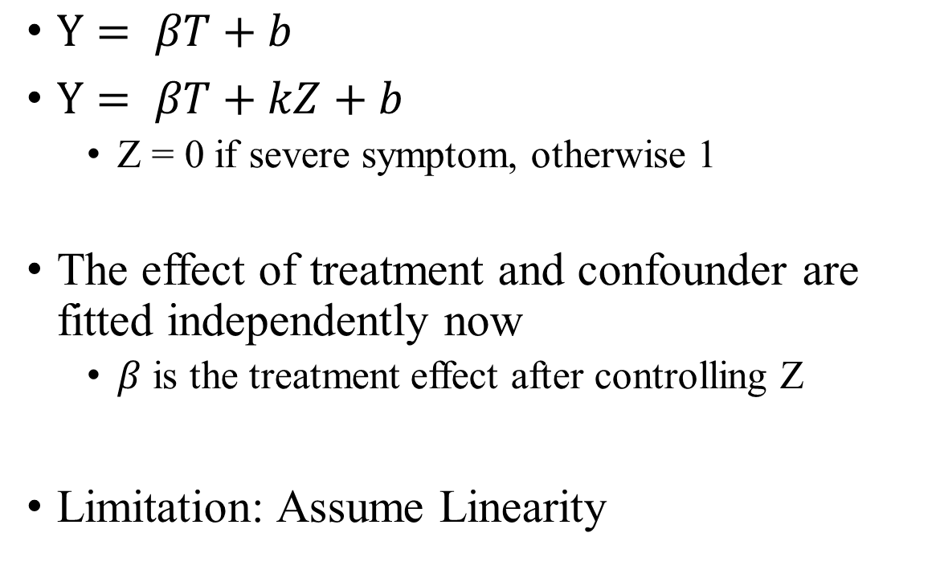


Multivariate Linear Regression
Mild
Severe
$Y= βT+b$
$Y= βT+kZ+b$
Z = 0 if severe symptom, otherwise 1
The effect of treatment and confounder are fitted independently now
$β$ is the treatment effect after controlling Z
Limitation: Assume Linearity
$$Y= βT+kZ+b (Z=1)$$
$$Y= βT+kZ+b (Z=0)$$
Notes:
The first tool to reduce bias in Quasi-Experiments is Multivariate Linear Regression.
Back to the example of Simpson’s paradox, we used a single variable regression to study the relation.
But when we include the third variable (1), the initial symptom severity, now we are actually using Multivariate Linear Regression.
We denote it as Z, and it is a binary variable, so we can show it on the 2D plot with 2 lines (2). The upper one is the regression result given Z=1 and the lower one is the regression result given Z=0.
We can already see from the graph that it can help reduce the bias, but how does it achieve this?
(3) It is because the effect of treatment and confounder are fitted independently now, so that beta is the treatment effect after controlling Z.
It is intuitive to see from the graph because Z is a constant for each line.
(4) But this method has a clear limitation, as it assumes linear relation between the 2 variables.

Slide 21
Matching
Essence of Causality: the potential outcome on the same individual given different treatment
We cannot give different treatments on the same individual
But we can find a “twin” to treat differently
Idea of Matching
Find a pair of similar individuals (“twins”) in treatment/control group respectively, and compare their outcome
Notes:
To handle more complex causal relations, we can use another technique called matching.
I will first give you some motivation. The essence of causality is xxx

Slide 22
Matching (Example)
Study the effect of education on salary
The Average salary of doctors are fewer than masters!
1700 / 4 > 800 / 2
Age is confounder!
Matching on confounders:
Nearest neighbor: (1-5, 2-6, 3-6, 4-6)
Estimated causal effect =
((250-200)+(550-500)+(550-440)+(550-560)) / 4 = 50 > 0
Education indeed raises salary
id | Education (T) | Age (Z) | Salary(Y)
1 | master | 30 | 200
2 | master | 35 | 500
3 | master | 34 | 440
4 | master | 36 | 560
5 | doctor | 30 | 250
6 | doctor | 35 | 550
Notes:
When we check the data, we can find a strange phenomenon, (1)
The Average salary of doctors are fewer than masters! (2)
If we take a closer look at the data, we can find that the masters in this dataset are generally more senior. So their high salary might be result of more working experience. So age is the confounder, and we need to reduce the bias it brought. (3)
So we will perform matching on age xxx. (4)
For each person, we find its nearest neighbor according to age, and we get xxx (5)
Then the estimated causal effect is the expected difference in outcome between all pairs. Xxx (6)

Slide 23
Quiz: Confounder
Admission Gender Bias in XX University
Which variable is the treatment, outcome and the confounder?
Treatment: Gender
Outcome: Admission Rate
Confounder: Department
Department | Men |  | Women
 | Applicants | Admitted | Applicants | Admitted
Social Science | 100 | 10% | 900 | 10%
Computer Science | 900 | 20% | 100 | 20%
Overall | 1000 | 18% | 1000 | 11%
Notes:
Now I will give you a quiz to test your understanding of confounder.
We suspect that there is gender bias in the admission rate of a university, so we collected some data.
We can see that men have a higher overall admission rate. However, when we split the data by department, we can see that the admission rate is equal for all departments.
So there must be a confounder affecting our conclusion, so my question is xxx (1)
The explanation for the strange phenomenon: Social Science has a generally lower admission rate, but most women applied for it, so even if the admission rate for each gender is the same within each department. The bias in the department caused different outcome.
Do you have another question so far?

Slide 24
Contents
Motivation
Methodology
Association
Causality
Applications in mental health research
Conclusion
Notes:
Now we will discuss the application of causality in mental health research, I will briefly discuss 2 papers

Slide 25
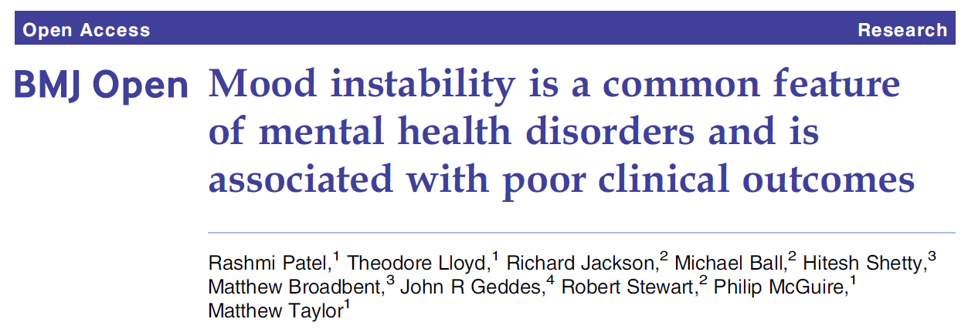
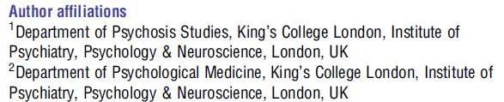

Notes:
The first paper is xxx published on a medical journal BMJ Open
(British Medical Journal)
BMJ Open is a proceeding, which is not top, but can still be considered good (IF 2.521，中科院分区 医学大类4区，小类3区)

Slide 26
Overview
Core Hypothesis: Mood instability is associated with poor clinical outcomes
Variables: Mood Instability (Treatment) – Clinical Outcome (Outcome)
Key Problems in Experiment Designs
Which design to use, RCT or Quasi-Experiment?
Latter, as we can not randomly sample people and control some of them to have mood instability like taking a drug
How can we measure these variables?
What are the possible confounders? How to reduce their confounding bias?
Notes:
From the title, we can easily see that the core hypothesis of this research is xxx
Where the treatment is xxx and the outcome is xxx
There are some key problems in Experiment designs

Slide 27
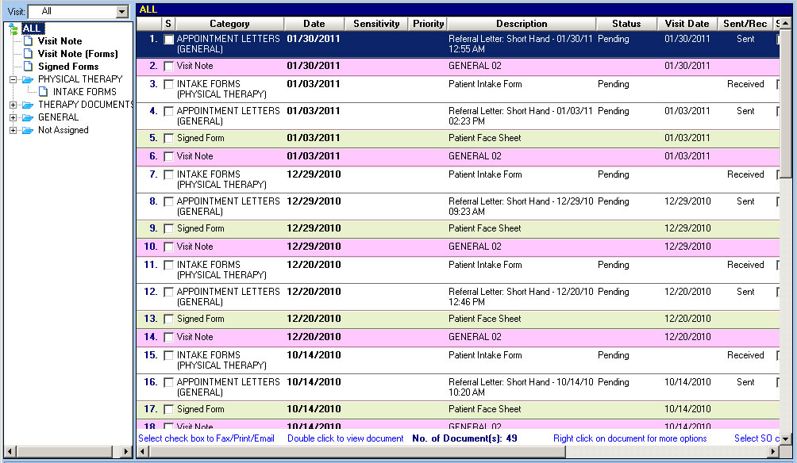
Data
Anonymized Electronic Health Record (EHR)
From an inpatient and community mental healthcare provider in the UK
27,704 patients with mental disorders
Notes:
Let’s see the data first. The data consists of the Anonymized Electronic Health Record (EHR) of 27,704 patients with mental disorders
EHR is semi-structured data with defined schema, but can also consists of free text like symptom description.
Here I provided an illustration. Although it is derived not from the paper, the data should look like this.
Best Physical Therapist Software | EMR-EHRS

Slide 28
Variable Measures
Treatment: Mood Instability
Detect with pattern matching in EHR (NLP)
E.g. (mood|affect|emotion) (instability|dysfunction)
Status Inference (Negation, Uncertainty) with Supervised ML algorithms
E.g. The patient doesn’t show mood instability
Outcome: Clinical Outcome
Primary: Number of days spent in Hospital
Secondary: Compulsory hospital admission rate, etc.
Notes:
So how can we get these variables from the EHR?
First, we will utilize the textual description in EHR to get the treatment variable. (1)
The health provider will usually write about such symptom in EHR with relatively standard patterns like xxx, so we can just use pattern matching to detect them. And we can consider this as a simple application of NLP. (2)
But just pattern matching is not enough, because there can also be negation or uncertainty (For example xxx), and we should take them into account.
So we will use supervised ML algorithm to conduct status inference. Then we will only take the positive expressions.
Next, we can use the structural data in the EHR to measure the outcome. (3)
The authors use Number of days spent in Hospital as the primary outcome, which can be calculated with the timestamp of records
They also include other secondary outcomes, like Compulsory hospital admission rate, etc.

Slide 29
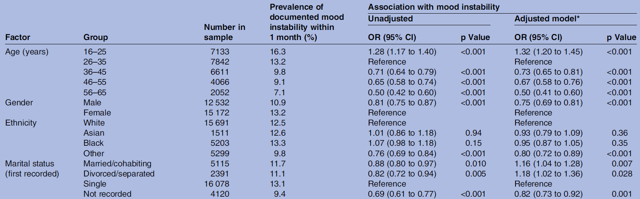
Confounders
Demographic attributes are usually important confounders
Check if they are associated with the treatment
Quiz: which factor’s effect is changed in the adjusted model?
Notes:
The next question is, what are the confounders?
Since we can get the Demographic attributes from HER and they are usually important confounders.
So we can check if they are associated with the treatment. If so, they are real confounders, and we should control them in the causal model.
The relation between demographics and mood instability are shown in this table. We can see that they really have relations.
The absolute value between different groups are different. (For example, we can see that xxx)
And the significant p-value can validate the relation.
The numbers showed here are from unadjusted model. That is, we consider the effect of each factor independently. (1)
We further make an adjusted model, where we will control all other factors when estimating the effect.
There seems to be some changes in the relation, and we can find them in the numbers.
So I have a quiz for you, which factor’s effect is changes in the adjusted model?
The answer is the Marital status. The OR of married over single is less than 1 in the unadjusted model, but it becomes larger than 1 after adjust.
So we can see that it’s actually the married people that are more likely to have mood instability, when we control other confounders.
*OR calculated with multi-variable Logistic Regression

Slide 30
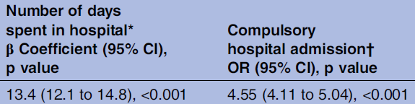

Results
After controlling for confounders with multi-variate regression
$β>0$, showing that mood instability increases hospital days
OR > 1, showing that mood instability increases admission rate
$⇒$ Mood instability is associated with poor clinical outcomes
Notes:
Now let’s see the final model between the treatment and the outcome.
We can see that the author used multi-variate linear regression that controlled all confounders that they have studied.
We can get our conclusions from these measures we’ve just learnt.
Beta, OR xxx, p-value
(1) So we can confidently conclude that Mood instability is associated with poor clinical outcomes

Slide 31
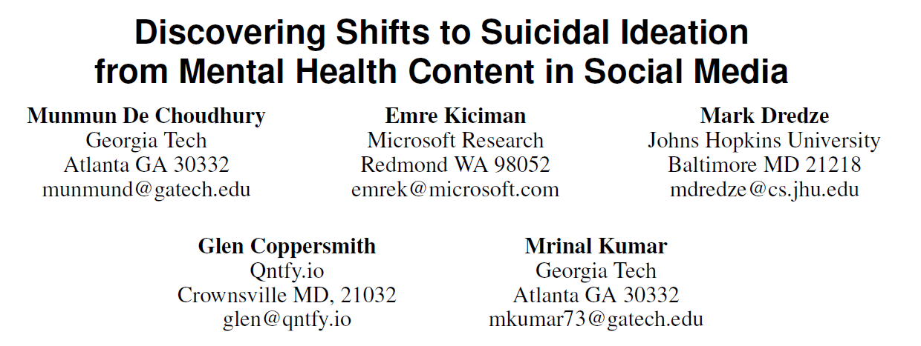
CHI’ 16
Notes:
The next paper is xxx, published in CHI’ 16. A CCF-A conference about Human Factors in Computing Systems.
CHI: ACM Conference on Human Factors in Computing Systems (CCF-A conference)

Slide 32
Overview
Task: Predicting Future Suicidal Ideas with Social Media posts
Preliminary Research: What can cause/prevent Future Suicidal Ideas?
Serve as feature for the prediction model
Provide valuable insights for human
Variables
Outcome: Future Suicidal Ideas
Treatments & Confounders: ?
Notes:
The major task of the paper is to predict Future Suicidal Ideas with Social Media posts, this is a machine learning problem
But they also conducted a preliminary research. They study what can cause or prevent Future Suicidal Ideas?
If we find the answers (1), then they can serve as xxx, and also provide valuable insights for human. So we will focus on this.
(2) Now we look at the variables involved in this study. The outcome is clear, that is the future suicidal ideas ()
(3) However, the treatments and confounders are all not clear. So we need to discover them ourselves.

Slide 33
Experiment Design
Which design to use, RCT or Quasi-Experiment?
Treatments and confounders unknown
Data from social media are observational, cannot control
Challenge is also opportunity
Social Media data is large in amount
We can freely discover any possible treatments
Notes:
There is also problems in Experiment Design.
Which design should we use, RCT or Quasi-Experiment? (1) (2)
First, We don’t even know what are the potential treatments and confounders, so we can’t control them
Moreover, the data is from social media posts. They are natural and observational, and it’s impossible to control them.
(3) But the above challenge is also opportunity. xxx

Slide 34
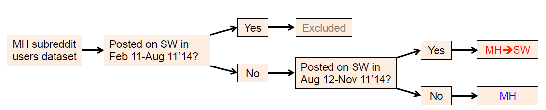
Data and Outcome Measurement
User posts from Reddit
MH: users posted on Mental Health related subreddits (forums)
SW: users who post in r/SuicideWatch (discussion and help about suicide)
Outcome
Divide the data by two time periods and study the transition likelihood
We consider MH->SW users as having Future Suicidal Ideations
Notes:
Let’s look at the data. They are user posts from Reddit. We use MH to stand for xxx and we use SW to represent xxx
To get the outcome variable, they divide the data by two time periods, and study the transition.
That is, if the user didn’t posted in SW in the first period, but joined SW in the second period, we may infer that he may have faced with something that will let him want to kill himself at the first period. So we consider MH->SW users as having Future Suicidal Ideations.

Slide 35
Treatments and Confounders
Many potential factors affecting mental health are expressed in posts
E.g. “I’m diagnosed with depression”, “I have no friend”, …
Treatment: the use of certain 1/2/3-gram in posts
E.g. “I”, “diagnosed”, “depression”, “no_friend”, …
The use of certain words are also associated with other words
E.g. Suffering from “depression” related to “no_friend”
Confounder: the use of 1/2/3-gram before using the treatment word
How to reduce the confounding bias?
Notes:
Now let’s see how can we find the treatments and confounders.
The posting text are free, so we can find that many potential factors affecting mental health are expressed in posts.
Such posts may include xxx
So here the authors define the use of certain 1/2/3-gram in posts as the treatment. So for the example above, the possible treatments are xxx
(2) Since the use of certain words are also associated with other words, xxx
(3) They are also confounders of each other. And since cause must happen before the effect. The authors define xxx to be the confounder
(4) Now we have defined treatment, outcome and confounder. The remaining problem is, how can we reduce the confounding bias?

Slide 36
Matching (example)
T: “no_friend” and Z: “depression” both contribute to Y: suicidal idea
Suffering from “depression” related to “no_friend”
Estimate causal effect with Matching
Group 1: Z: “depression” × before T: “no_friend” ×
Group 2: Z: “depression” × before T: “no_friend” √
Group 3: Z: “depression” √ before T: “no_friend” ×
Group 4: Z: “depression” √ before T: “no_friend” √
Estimated effect of T: “no_friend” =
E(MH->SW|T =√, group2, 4) - E(MH->SW|T=×, group1, 3)
In practice: Propensity Score Matching (PSM)
Z
T
Y
Notes:
Since the relation between variables can be much more complex than linear, the authors uses matching to reduce confounding bias.
I will illustrate their idea with a simplified example. Where the treatment xxx
When we want to estimate the causal effect with Matching,
we divide the data into 4 groups according to the value of the treatment and the confounder.
Then the estimated effect of T is the expected difference when T is True and T is False. That is the difference between group 2,4 and 1,3
In practice, there are too many variables, so the authors used an improved method called PSM. I will not discuss the details, but the idea is similar.

Slide 37
Results
Tokens that increase the likelihood of posting in SW
Mental Diseases: Depression(+30%), Anxiety(+24%)
Others: no_friend(+51%), to_cry(+51%)
Mental disease and poor social relation/mood can increase suicide risk
Tokens that decrease the likelihood of posting in SW
Counseling
Relationship_that, hope_it, and_enjoy
Social ties, optimism, hobbies and therapy helps reduce suicide risk
Notes:
Now let’s see what we can discover from the data.
We first find Tokens that increase the likelihood of posting in SW. They include xxx.
(1) They show that Mental disease and poor social relation/mood can increase the risk
(2) We then check which tokens can decrease the likelihood of posting in SW
(3) We can see “counseling” that indicates a therapy, we can also see xxx
(4) So we may conclude that Social ties, optimism, hobbies and therapy helps reduce suicide risk

Slide 38
Contents
Motivation
Methodology
Association
Causality
Applications in mental health research
Conclusion

Slide 39
Conclusion
Data Science: make scientific discoveries for human
Focus of Data Science
Reliability of the conclusions
Hypothesis test, P-value, …
Strength of the relation
Odds Ratio(OR), beta coefficient, Pearson’s r, …
From Association to Causality
Reducing the confounding bias
Methods: RCT, Multi-variable regression, Matching, …
Notes:
The focus of today’s talk is data science, which aims to xxx

Slide 40
Thanks!

Slide 41
Discussion
ML&NLP can support Data Science discoveries
We’ve seen: Freely mine effective treatments for suicide on web
Future: (Given that our recent work can detect mental disease symptoms)
We may study what treatments can ease symptoms
Data Science discoveries can also help ML
We’ve seen: Discovered important treatments as features for ML models
Future: inspire new modeling ideas with discoveries in data
Notes:
This talk is also intended to inspire future works, so I have invited my collaborators to this seminar.
Here I want to discuss my inspirations from these works.
We’ve already seen that ML can enable us to freely mine effective treatments for suicide on web.
In the future, given that our recent work can detect mental disease symptoms, we can also study what treatments can ease symptoms

